Slide 1

HR Analytics – Employee Attrition
Business Case.
Data Description.
Data Preparation.
DATA exploration.
Insights.
Attrition prediction.
Timeline of attrition.
Way forward.

Slide 2
BUSINESS CASE
In this case study, we will explore a real life HR dataset of a company and apply analytics to investigate why people are leaving there.
The case study is in two parts:
We will use visualization to generate insights as to the plausible causes of attrition.
Then we will build machine learning model to compare our findings and select a model to make predictions.

Slide 3
DATA DESCRIPTION
Rehire | Terminated | Employee_code | Department | Job Level | Tenure | TimeLastPos | Has been promoted | LastRating | Client work travel | Education | Gender | Marital Status | Annual Income | Year of Birth
FALSE | 1 | 140384 | Risk Management | Senior Analyst | 253 | 253 | No | 1.965571042 | High Travel | Bachelors Degree | F | Single | 1678 | 1963
FALSE | 1 | 120921 | Tax | Senior Analyst | 1384 | 118 | Yes | 1 | Medium Travel | Bachelors Degree | M | Married | 2144 | 1966
FALSE | 1 | 88512 | Audit | Staff I | 1188 | 482 | Yes | 2 | Medium Travel | Msc Analytics | M | Married | 584 | 1977
FALSE | 1 | 80636 | Financial Advisory | Lead Analyst | 1013 | 1013 | No | 2 | Medium Travel | MA | F | Married | 6205 | 1970
FALSE | 0 | 123543 | Sales | Lead Analyst | 1300 | 1132 | Yes | 2 | Medium Travel | MA | F | Married | 6986 | 1970
FALSE | 1 | 32530 | Tax | Lead Analyst | 1020 | 1020 | No | 3 | High Travel | Bachelors Degree | F | Single | 4494 | 1985
FALSE | 1 | 124815 | Finance | Staff I | 4352 | 1357 | Yes | 2 | High Travel | MSc | F | Divorced | 334 | 1987
FALSE | 1 | 76118 | Audit | Senior Analyst | 1025 | 306 | Yes | 2 | Medium Travel | Bcom | M | Married | 1817 | 1989
FALSE | 1 | 99950 | Financial Advisory | Staff II | 1761 | 894 | Yes | 2 | Medium Travel | Bcom | M | Married | 2289 | 1988
FALSE | 1 | 54216 | Audit | Staff I | 1566 | 384 | Yes | 2 | High Travel | MSc | F | Divorced | 355 | 1978
Categorical explanatory variables : Rehire, Department, Job Level, HasbeenPromoted, ClientWorkTravel, Education,Gender,Marital Status.
Numerical explanatory variables : Tenure, TimeLastPos, LastRating, Annual Income.
Date field : Year of Birth.
Response variable : Terminated (1 – Left, 0 – Stayed)

Slide 4
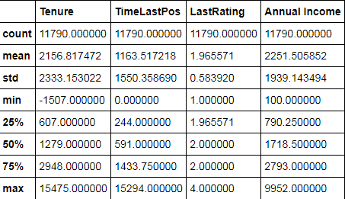
DATA PREPARATION .. 1
The data is more or less proper albeit some missing / wrong information:
1. There are 41 records which contain no department information – assigned unknown category to Department in these records.
2. There are 10 records where Tenure is negative.
Since it is only 0.08% of the sample I have removed them.
3. Next we will explore how Tenure and Days since last promotion
is affecting decisions of leaving or staying.

Slide 5
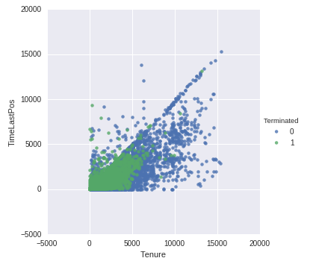
DATA PREPARATION .. 2
There is a large number of people leaving where both the Tenure and TimeLastPos are very low and also zero.
Also it is evident that at some places the TimeLastPos is less than the Tenure which is clearly absurd.
There are 1278 records which contain Tenure values which are less than TimeLastPos and where TimeLastPos = 0.
<Insert another slide here>
For the records where TimeLastPos = 0 it can be assumed that they have been promoted recently and it is not updated in the system.But what about the records where Tenure < TimeLastPos. It is clearly an error and in absence of interaction with the database maintainer/business, inclination is to either remove such records or remove the variable TimeLastPos. But let's see the distribution of Terminated in these set of records.

Slide 6
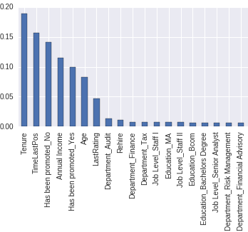
DATA PREPARATION.. 3
There are a total to 1288 records where either the Tenure is less than Days since last promotion or TimeLastPos is 0. Also in all these records where TimeLastPos = 0 the field has been promoted is ‘Yes’ which is clearly a contradiction.
Removing 1288 records will result in a loss of more than 10% of the sample.
We will find out how important the variable TimeLastPos is for predicting Attrition by using Random Forest feature importance.
Though it is the second most important
Variable it is also highly correlated (77%) with Tenure.
Hence for modeling attrition we will use not
use TimeLastPos .

Slide 7
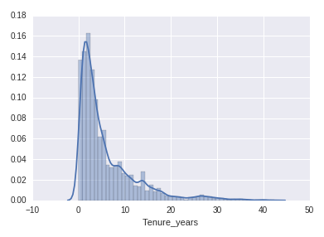
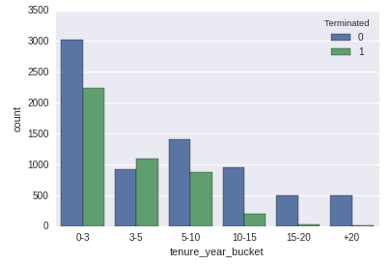
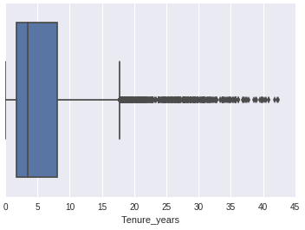
DATA EXPLORATION
Let us take a look at Tenure (converted in years)
The distribution is right skewed with many people who have been in the company for a long time (15 + years.)
If we take a look at the Attrition by Tenure buckets we can see that most of the people are leaving in the 0-3 to 5-10 years range.
The 3-5 bracket has the most attrition.

Slide 8
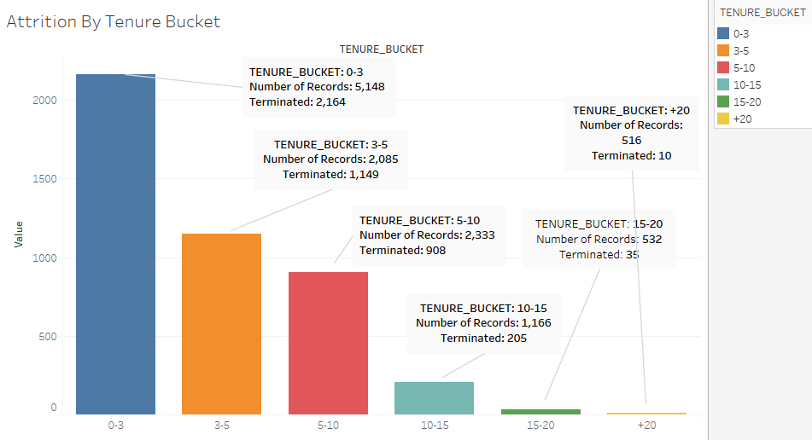
Attrition by Tenure Bucket
Attrition in percentages:
Attrition % | Tenure_Bucket
42% | 0-3
55% | 3-5
38% | 5-10
17% | 10-15
6.50% | 15-20
25% | +20
The maximum attrition is in the 3-5 years Tenure bracket followed by 0-3 years.

Slide 9
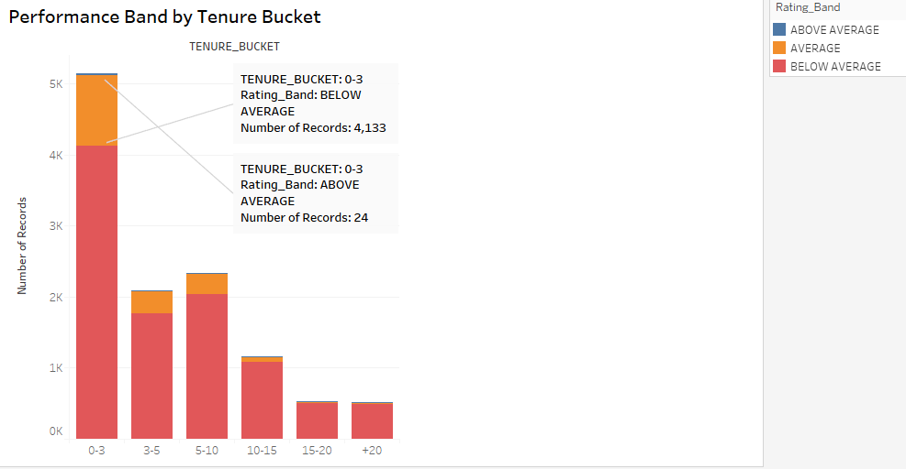
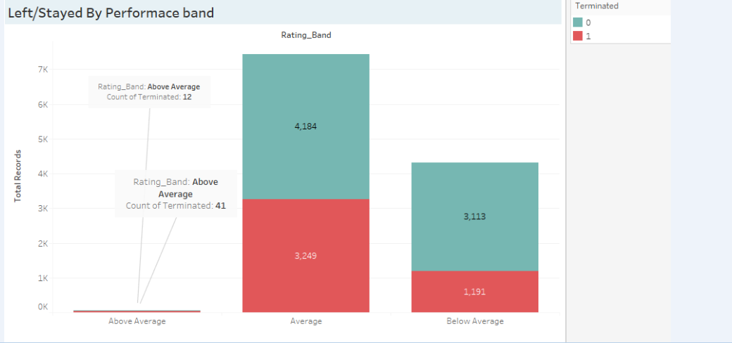
Performance Issues?
Let us see the performance of employees across tenure buckets.

Slide 10
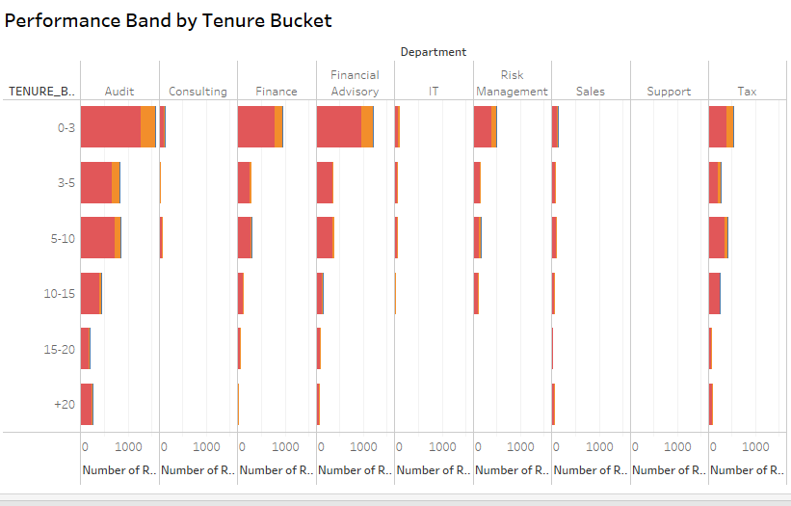
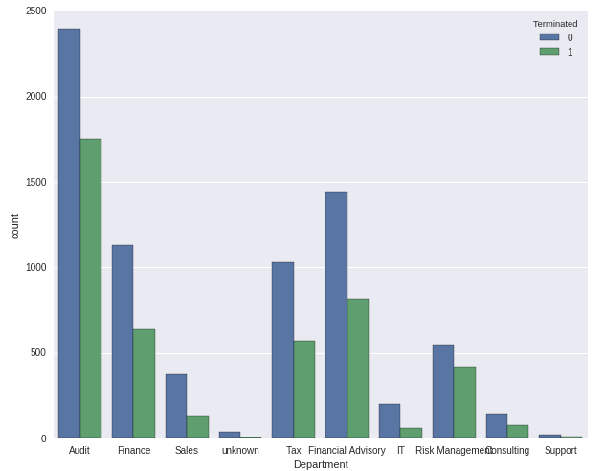
Departmental Problems?

Slide 11
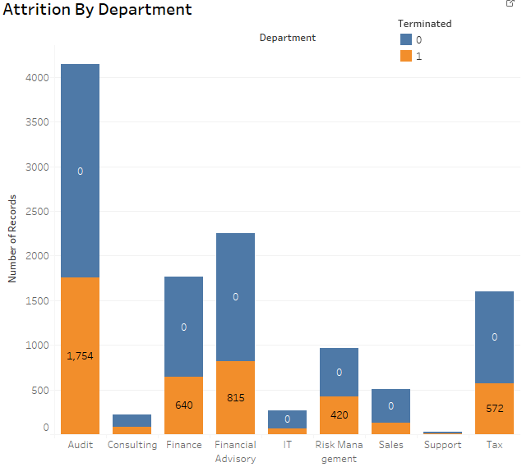
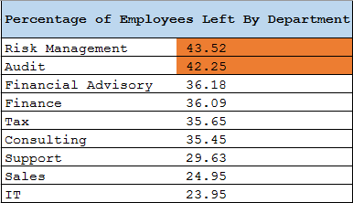
Attrition By Departments:

